Slide 1

Cyber-security
Protecting Your Child

Slide 2
Notes:
When dealing with cybercrime, an ounce of prevention is truly worth a pound of cure. Cybercrime in its many forms (e.g., online identity theft, financial fraud, stalking, bullying, hacking, email spoofing, information piracy and forgery and intellectual property crime) can, at best, wreak havoc in victims’ lives through major inconvenience and annoyance. At worst, cybercrime can lead to financial ruin and potentially threaten a victim’s reputation and personal safety.

Slide 3
Cybercrime
Online Identity Theft
Financial Fraud
Stalking
Bullying
Hacking
Email Spoofing
Notes:
When dealing with cybercrime, an ounce of prevention is truly worth a pound of cure. Cybercrime in its many forms (e.g., online identity theft, financial fraud, stalking, bullying, hacking, email spoofing, information piracy and forgery and intellectual property crime) can, at best, wreak havoc in victims’ lives through major inconvenience and annoyance. At worst, cybercrime can lead to financial ruin and potentially threaten a victim’s reputation and personal safety.

Slide 4

Topics
Identity Theft
Social Media
Savvy Cyber Kids

Slide 5
Identity Theft
Notes:
Consider talking about:
Federal government
State governments
Proposed regulation
Other government efforts

Slide 6
Identity Theft:
What is it?

Slide 7
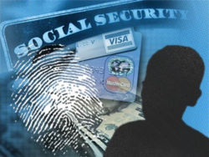
Identity Theft
The use or attempt to use personal information of another person to commit fraud.
Defined in the Fair Credit Reporting Act (FCRA):
  “Identifying information” is any name or number that may be used, alone or in conjunction with any other information, to identify a specific person . . .
Notes:
Keith
Under federal law, identity theft occurs when someone uses or attempts to use the sensitive personal information of another person to commit fraud.
The Fair Credit Reporting Act (FCRA) defines identity theft as “a fraud committed or attempted using the identifying information of another person without authority.” “Identifying information” is “any name or number that may be used, alone or in conjunction with any other information, to identify a specific person . . . ” Fair Credit Reporting Act, Pub.L. 108-159, sec 111, 15 U.S.C. § 1681a; 16 C.F.R §603.2.
Personal info:
Name and/or Address
Date of birth
Social Security number
Driver's license number
Checking and savings accounts
Credit or debit card numbers
Personal identification numbers (PIN)
Electronic identification codes
Automated or electronic signatures
Biometric data
Fingerprints
Passwords
Parent's legal surname prior to marriage

Slide 8
Identity Theft:
Types

Slide 9
Financial Information Identity Theft
Financial information identity theft is usually the result of fraud related to someone's existing and/or new credit account. This can include credit card accounts, checking or savings accounts, brokerage accounts, or any other kind of account maintained by a financial institution. It can also include the unauthorized use of existing or new utility accounts including cell phones.
Notes:
Keith
There are two main types of such financial frauds: 1) the use of the victim’s existing credit, bank, or other accounts; or 2) the opening of new accounts in the victim’s name. Many times victims experience both.
Existing Accounts:
According to FTC , about 75% of victims report that the thief misused only their existing accounts.
Credit card accounts are the most commonly misused existing account.
Done by skimming, theft of the cards, etc.
New Accounts:
25% of victims report that thief opened new accounts or committed other types of fraud with the personal info.
Phone accounts, usually wireless: most common type of new account opened by identity thieves.
Thieves also open or raid bank accounts, internet payment accounts, & auto, personal, student loan accounts.
Thief is using personal info of victim to create a new account (may even assume victim’s identity to do so).

Slide 10
Financial Information Identity Theft
Financial information can be stolen in a number of ways, such as:
Dumpster diving - looking for personal information in trash receptacles
Stealing mail - simple habits such as leaving the red flag up to indicate mail is to be picked up by their postal carrier, can put a household at great risk of identity thieves who target mailboxes, looking for checks, credit card information, and other financial information to commit identity theft
Computer hacking
Notes:
Keith
There are two main types of such financial frauds: 1) the use of the victim’s existing credit, bank, or other accounts; or 2) the opening of new accounts in the victim’s name. Many times victims experience both.
Existing Accounts:
According to FTC , about 75% of victims report that the thief misused only their existing accounts.
Credit card accounts are the most commonly misused existing account.
Done by skimming, theft of the cards, etc.
New Accounts:
25% of victims report that thief opened new accounts or committed other types of fraud with the personal info.
Phone accounts, usually wireless: most common type of new account opened by identity thieves.
Thieves also open or raid bank accounts, internet payment accounts, & auto, personal, student loan accounts.
Thief is using personal info of victim to create a new account (may even assume victim’s identity to do so).

Slide 11
Financial Information Identity Theft
Financial information can be stolen in a number of ways, such as:
Using skimmers - magnetic stripe reading and storage devices that can be installed over the top of existing card readers. Criminals use credit-card skimming devices to store data that can be used later for identity theft. Typically, bank ATM machines are the target of such scams.
Wardriving - the act of searching for Wi-Fi wireless networks by a person in a moving vehicle, using a portable computer.
Notes:
Keith
There are two main types of such financial frauds: 1) the use of the victim’s existing credit, bank, or other accounts; or 2) the opening of new accounts in the victim’s name. Many times victims experience both.
Existing Accounts:
According to FTC , about 75% of victims report that the thief misused only their existing accounts.
Credit card accounts are the most commonly misused existing account.
Done by skimming, theft of the cards, etc.
New Accounts:
25% of victims report that thief opened new accounts or committed other types of fraud with the personal info.
Phone accounts, usually wireless: most common type of new account opened by identity thieves.
Thieves also open or raid bank accounts, internet payment accounts, & auto, personal, student loan accounts.
Thief is using personal info of victim to create a new account (may even assume victim’s identity to do so).

Slide 12
Financial Information Identity Theft
Financial information can be stolen in a number of ways, such as:
Phishing - the criminally fraudulent process of attempting to acquire sensitive information such as usernames, passwords and credit card details by masquerading as a trustworthy entity in an electronic communication.
Shoulder surfing - using direct observation techniques, such as looking over someone's shoulder, to get information.
Notes:
Keith
There are two main types of such financial frauds: 1) the use of the victim’s existing credit, bank, or other accounts; or 2) the opening of new accounts in the victim’s name. Many times victims experience both.
Existing Accounts:
According to FTC , about 75% of victims report that the thief misused only their existing accounts.
Credit card accounts are the most commonly misused existing account.
Done by skimming, theft of the cards, etc.
New Accounts:
25% of victims report that thief opened new accounts or committed other types of fraud with the personal info.
Phone accounts, usually wireless: most common type of new account opened by identity thieves.
Thieves also open or raid bank accounts, internet payment accounts, & auto, personal, student loan accounts.
Thief is using personal info of victim to create a new account (may even assume victim’s identity to do so).

Slide 13
Benefit Fraud
This type of theft involves personal services or benefit money such as Social Security benefits, Medicare, Medicaid, medical or other insurance, or other government benefits.
Notes:
Keith
There are two main types of such financial frauds: 1) the use of the victim’s existing credit, bank, or other accounts; or 2) the opening of new accounts in the victim’s name. Many times victims experience both.
Existing Accounts:
According to FTC , about 75% of victims report that the thief misused only their existing accounts.
Credit card accounts are the most commonly misused existing account.
Done by skimming, theft of the cards, etc.
New Accounts:
25% of victims report that thief opened new accounts or committed other types of fraud with the personal info.
Phone accounts, usually wireless: most common type of new account opened by identity thieves.
Thieves also open or raid bank accounts, internet payment accounts, & auto, personal, student loan accounts.
Thief is using personal info of victim to create a new account (may even assume victim’s identity to do so).

Slide 14
Identity Cloning
Identity cloning is the complete impersonation of the victim. This can include the fraudulent copying of a person's professional license, e.g., medical or law license, or taking the identity of someone else based on their social security number and birth certificate.
Notes:
Keith
There are two main types of such financial frauds: 1) the use of the victim’s existing credit, bank, or other accounts; or 2) the opening of new accounts in the victim’s name. Many times victims experience both.
Existing Accounts:
According to FTC , about 75% of victims report that the thief misused only their existing accounts.
Credit card accounts are the most commonly misused existing account.
Done by skimming, theft of the cards, etc.
New Accounts:
25% of victims report that thief opened new accounts or committed other types of fraud with the personal info.
Phone accounts, usually wireless: most common type of new account opened by identity thieves.
Thieves also open or raid bank accounts, internet payment accounts, & auto, personal, student loan accounts.
Thief is using personal info of victim to create a new account (may even assume victim’s identity to do so).

Slide 15
Data Collections Fraud
This type of identity theft happens when thieves use high tech devices to retrieve personal identifying information from other devices. It includes computer hacking and also:
Notes:
Keith
There are two main types of such financial frauds: 1) the use of the victim’s existing credit, bank, or other accounts; or 2) the opening of new accounts in the victim’s name. Many times victims experience both.
Existing Accounts:
According to FTC , about 75% of victims report that the thief misused only their existing accounts.
Credit card accounts are the most commonly misused existing account.
Done by skimming, theft of the cards, etc.
New Accounts:
25% of victims report that thief opened new accounts or committed other types of fraud with the personal info.
Phone accounts, usually wireless: most common type of new account opened by identity thieves.
Thieves also open or raid bank accounts, internet payment accounts, & auto, personal, student loan accounts.
Thief is using personal info of victim to create a new account (may even assume victim’s identity to do so).

Slide 16
Data Collections Fraud
• Skimmers - devices that read the information from the magnetic strip of credit cards or ATM cards
• Wardriving - devices that are usually placed in vehicles that can retrieve information from unencrypted wireless internet connections
Notes:
Keith
There are two main types of such financial frauds: 1) the use of the victim’s existing credit, bank, or other accounts; or 2) the opening of new accounts in the victim’s name. Many times victims experience both.
Existing Accounts:
According to FTC , about 75% of victims report that the thief misused only their existing accounts.
Credit card accounts are the most commonly misused existing account.
Done by skimming, theft of the cards, etc.
New Accounts:
25% of victims report that thief opened new accounts or committed other types of fraud with the personal info.
Phone accounts, usually wireless: most common type of new account opened by identity thieves.
Thieves also open or raid bank accounts, internet payment accounts, & auto, personal, student loan accounts.
Thief is using personal info of victim to create a new account (may even assume victim’s identity to do so).

Slide 17
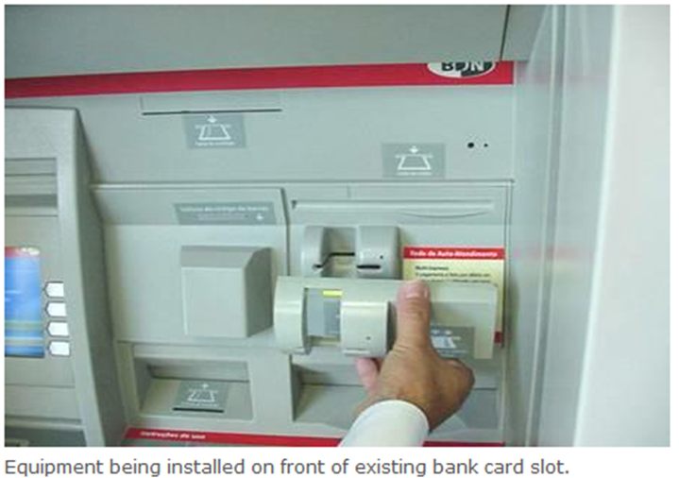
Data Collections Fraud
Notes:
Keith
There are two main types of such financial frauds: 1) the use of the victim’s existing credit, bank, or other accounts; or 2) the opening of new accounts in the victim’s name. Many times victims experience both.
Existing Accounts:
According to FTC , about 75% of victims report that the thief misused only their existing accounts.
Credit card accounts are the most commonly misused existing account.
Done by skimming, theft of the cards, etc.
New Accounts:
25% of victims report that thief opened new accounts or committed other types of fraud with the personal info.
Phone accounts, usually wireless: most common type of new account opened by identity thieves.
Thieves also open or raid bank accounts, internet payment accounts, & auto, personal, student loan accounts.
Thief is using personal info of victim to create a new account (may even assume victim’s identity to do so).

Slide 18
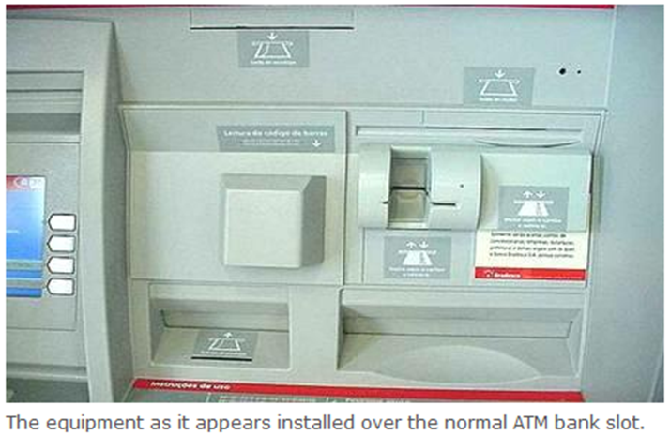
Data Collections Fraud
Notes:
Keith
There are two main types of such financial frauds: 1) the use of the victim’s existing credit, bank, or other accounts; or 2) the opening of new accounts in the victim’s name. Many times victims experience both.
Existing Accounts:
According to FTC , about 75% of victims report that the thief misused only their existing accounts.
Credit card accounts are the most commonly misused existing account.
Done by skimming, theft of the cards, etc.
New Accounts:
25% of victims report that thief opened new accounts or committed other types of fraud with the personal info.
Phone accounts, usually wireless: most common type of new account opened by identity thieves.
Thieves also open or raid bank accounts, internet payment accounts, & auto, personal, student loan accounts.
Thief is using personal info of victim to create a new account (may even assume victim’s identity to do so).

Slide 19
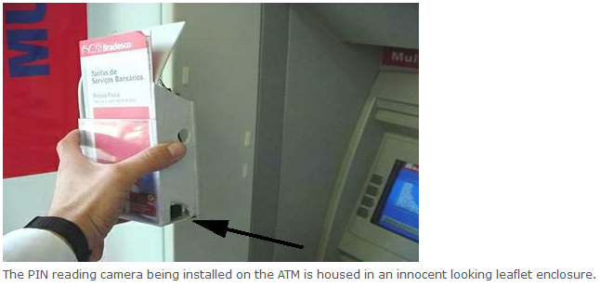
Data Collections Fraud
Notes:
Keith
There are two main types of such financial frauds: 1) the use of the victim’s existing credit, bank, or other accounts; or 2) the opening of new accounts in the victim’s name. Many times victims experience both.
Existing Accounts:
According to FTC , about 75% of victims report that the thief misused only their existing accounts.
Credit card accounts are the most commonly misused existing account.
Done by skimming, theft of the cards, etc.
New Accounts:
25% of victims report that thief opened new accounts or committed other types of fraud with the personal info.
Phone accounts, usually wireless: most common type of new account opened by identity thieves.
Thieves also open or raid bank accounts, internet payment accounts, & auto, personal, student loan accounts.
Thief is using personal info of victim to create a new account (may even assume victim’s identity to do so).

Slide 20
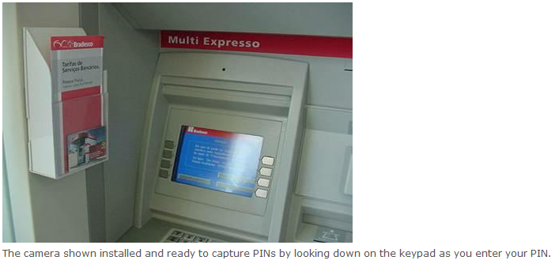
Data Collections Fraud
Notes:
Keith
There are two main types of such financial frauds: 1) the use of the victim’s existing credit, bank, or other accounts; or 2) the opening of new accounts in the victim’s name. Many times victims experience both.
Existing Accounts:
According to FTC , about 75% of victims report that the thief misused only their existing accounts.
Credit card accounts are the most commonly misused existing account.
Done by skimming, theft of the cards, etc.
New Accounts:
25% of victims report that thief opened new accounts or committed other types of fraud with the personal info.
Phone accounts, usually wireless: most common type of new account opened by identity thieves.
Thieves also open or raid bank accounts, internet payment accounts, & auto, personal, student loan accounts.
Thief is using personal info of victim to create a new account (may even assume victim’s identity to do so).

Slide 21
Medical Identity Theft
Medical identity theft involves falsely obtaining medical care using someone's stolen identity.
Notes:
Keith
There are two main types of such financial frauds: 1) the use of the victim’s existing credit, bank, or other accounts; or 2) the opening of new accounts in the victim’s name. Many times victims experience both.
Existing Accounts:
According to FTC , about 75% of victims report that the thief misused only their existing accounts.
Credit card accounts are the most commonly misused existing account.
Done by skimming, theft of the cards, etc.
New Accounts:
25% of victims report that thief opened new accounts or committed other types of fraud with the personal info.
Phone accounts, usually wireless: most common type of new account opened by identity thieves.
Thieves also open or raid bank accounts, internet payment accounts, & auto, personal, student loan accounts.
Thief is using personal info of victim to create a new account (may even assume victim’s identity to do so).

Slide 22
Cyber Identity Theft
Cyber crime encompasses any criminal act dealing with computers and networks. Additionally, cyber crime also includes traditional crimes conducted through the Internet.
Notes:
Keith
There are two main types of such financial frauds: 1) the use of the victim’s existing credit, bank, or other accounts; or 2) the opening of new accounts in the victim’s name. Many times victims experience both.
Existing Accounts:
According to FTC , about 75% of victims report that the thief misused only their existing accounts.
Credit card accounts are the most commonly misused existing account.
Done by skimming, theft of the cards, etc.
New Accounts:
25% of victims report that thief opened new accounts or committed other types of fraud with the personal info.
Phone accounts, usually wireless: most common type of new account opened by identity thieves.
Thieves also open or raid bank accounts, internet payment accounts, & auto, personal, student loan accounts.
Thief is using personal info of victim to create a new account (may even assume victim’s identity to do so).

Slide 23
Cyber Identity Theft
• Viruses - A computer virus attaches itself to a program or file enabling it to spread from one computer to another, leaving infections as it travels. Like a human virus, a computer virus can range in severity: some may cause only mildly annoying effects while others can damage your hardware, software or files.
Notes:
Keith
There are two main types of such financial frauds: 1) the use of the victim’s existing credit, bank, or other accounts; or 2) the opening of new accounts in the victim’s name. Many times victims experience both.
Existing Accounts:
According to FTC , about 75% of victims report that the thief misused only their existing accounts.
Credit card accounts are the most commonly misused existing account.
Done by skimming, theft of the cards, etc.
New Accounts:
25% of victims report that thief opened new accounts or committed other types of fraud with the personal info.
Phone accounts, usually wireless: most common type of new account opened by identity thieves.
Thieves also open or raid bank accounts, internet payment accounts, & auto, personal, student loan accounts.
Thief is using personal info of victim to create a new account (may even assume victim’s identity to do so).

Slide 24
Cyber Identity Theft
• Worms - A worm is similar to a virus by design and is considered to be a sub-class of a virus. Worms spread from computer to computer, but unlike a virus, it has the capability to travel without any human action. A worm takes advantage of file or information transport features on your system, which is what allows it to travel unaided…
Notes:
Keith
There are two main types of such financial frauds: 1) the use of the victim’s existing credit, bank, or other accounts; or 2) the opening of new accounts in the victim’s name. Many times victims experience both.
Existing Accounts:
According to FTC , about 75% of victims report that the thief misused only their existing accounts.
Credit card accounts are the most commonly misused existing account.
Done by skimming, theft of the cards, etc.
New Accounts:
25% of victims report that thief opened new accounts or committed other types of fraud with the personal info.
Phone accounts, usually wireless: most common type of new account opened by identity thieves.
Thieves also open or raid bank accounts, internet payment accounts, & auto, personal, student loan accounts.
Thief is using personal info of victim to create a new account (may even assume victim’s identity to do so).

Slide 25
Cyber Identity Theft
• Trojan Horses - A Trojan Horse is full of as much trickery as the mythological Trojan Horse after which it was named. The Trojan Horse, at first glance, will appear to be useful software but will actually do damage once installed or run on your computer…
Notes:
Keith
There are two main types of such financial frauds: 1) the use of the victim’s existing credit, bank, or other accounts; or 2) the opening of new accounts in the victim’s name. Many times victims experience both.
Existing Accounts:
According to FTC , about 75% of victims report that the thief misused only their existing accounts.
Credit card accounts are the most commonly misused existing account.
Done by skimming, theft of the cards, etc.
New Accounts:
25% of victims report that thief opened new accounts or committed other types of fraud with the personal info.
Phone accounts, usually wireless: most common type of new account opened by identity thieves.
Thieves also open or raid bank accounts, internet payment accounts, & auto, personal, student loan accounts.
Thief is using personal info of victim to create a new account (may even assume victim’s identity to do so).

Slide 26
Cyber Identity Theft
• Zombies - A zombie computer (often shortened as zombie) is a computer attached to the Internet that has been compromised by a hacker, a computer virus, or a Trojan Horse. Generally, a compromised machine is only one of many in a botnet, and will be used to perform malicious tasks of one sort or another under remote direction…
Notes:
Keith
There are two main types of such financial frauds: 1) the use of the victim’s existing credit, bank, or other accounts; or 2) the opening of new accounts in the victim’s name. Many times victims experience both.
Existing Accounts:
According to FTC , about 75% of victims report that the thief misused only their existing accounts.
Credit card accounts are the most commonly misused existing account.
Done by skimming, theft of the cards, etc.
New Accounts:
25% of victims report that thief opened new accounts or committed other types of fraud with the personal info.
Phone accounts, usually wireless: most common type of new account opened by identity thieves.
Thieves also open or raid bank accounts, internet payment accounts, & auto, personal, student loan accounts.
Thief is using personal info of victim to create a new account (may even assume victim’s identity to do so).

Slide 27
Cyber Identity Theft
• Botnets - This word is generally used to refer to a collection of compromised computers (usually zombies) running software, usually installed via worms, Trojan Horses, or backdoors, under a common command-and-control infrastructure. A botnet's originator can control the group remotely, usually for nefarious purposes.
Notes:
Keith
There are two main types of such financial frauds: 1) the use of the victim’s existing credit, bank, or other accounts; or 2) the opening of new accounts in the victim’s name. Many times victims experience both.
Existing Accounts:
According to FTC , about 75% of victims report that the thief misused only their existing accounts.
Credit card accounts are the most commonly misused existing account.
Done by skimming, theft of the cards, etc.
New Accounts:
25% of victims report that thief opened new accounts or committed other types of fraud with the personal info.
Phone accounts, usually wireless: most common type of new account opened by identity thieves.
Thieves also open or raid bank accounts, internet payment accounts, & auto, personal, student loan accounts.
Thief is using personal info of victim to create a new account (may even assume victim’s identity to do so).

Slide 28
Cyber Identity Theft
• Spyware - Spyware is computer software that is installed surreptitiously on a personal computer to collect information about a user, their computer or browsing habits without the user's informed consent.
Notes:
Keith
There are two main types of such financial frauds: 1) the use of the victim’s existing credit, bank, or other accounts; or 2) the opening of new accounts in the victim’s name. Many times victims experience both.
Existing Accounts:
According to FTC , about 75% of victims report that the thief misused only their existing accounts.
Credit card accounts are the most commonly misused existing account.
Done by skimming, theft of the cards, etc.
New Accounts:
25% of victims report that thief opened new accounts or committed other types of fraud with the personal info.
Phone accounts, usually wireless: most common type of new account opened by identity thieves.
Thieves also open or raid bank accounts, internet payment accounts, & auto, personal, student loan accounts.
Thief is using personal info of victim to create a new account (may even assume victim’s identity to do so).

Slide 29
Cyber Identity Theft
• Hackers - People committed to the circumvention of computer security. This primarily concerns unauthorized remote computer break-ins via a communication network such as the Internet…
Notes:
Keith
There are two main types of such financial frauds: 1) the use of the victim’s existing credit, bank, or other accounts; or 2) the opening of new accounts in the victim’s name. Many times victims experience both.
Existing Accounts:
According to FTC , about 75% of victims report that the thief misused only their existing accounts.
Credit card accounts are the most commonly misused existing account.
Done by skimming, theft of the cards, etc.
New Accounts:
25% of victims report that thief opened new accounts or committed other types of fraud with the personal info.
Phone accounts, usually wireless: most common type of new account opened by identity thieves.
Thieves also open or raid bank accounts, internet payment accounts, & auto, personal, student loan accounts.
Thief is using personal info of victim to create a new account (may even assume victim’s identity to do so).

Slide 30
Cyber Identity Theft
• Keystroke logger - Keystroke logging is the practice of noting (or logging) the keys struck on a keyboard, typically in a covert manner so that the person using the keyboard is unaware that their actions are being monitored.
Notes:
Keith
There are two main types of such financial frauds: 1) the use of the victim’s existing credit, bank, or other accounts; or 2) the opening of new accounts in the victim’s name. Many times victims experience both.
Existing Accounts:
According to FTC , about 75% of victims report that the thief misused only their existing accounts.
Credit card accounts are the most commonly misused existing account.
Done by skimming, theft of the cards, etc.
New Accounts:
25% of victims report that thief opened new accounts or committed other types of fraud with the personal info.
Phone accounts, usually wireless: most common type of new account opened by identity thieves.
Thieves also open or raid bank accounts, internet payment accounts, & auto, personal, student loan accounts.
Thief is using personal info of victim to create a new account (may even assume victim’s identity to do so).

Slide 31
Cyber Identity Theft
• Wardriving - The act of searching for
Wi-Fi wireless networks by a person in a moving vehicle, using a portable computer.
Notes:
Keith
There are two main types of such financial frauds: 1) the use of the victim’s existing credit, bank, or other accounts; or 2) the opening of new accounts in the victim’s name. Many times victims experience both.
Existing Accounts:
According to FTC , about 75% of victims report that the thief misused only their existing accounts.
Credit card accounts are the most commonly misused existing account.
Done by skimming, theft of the cards, etc.
New Accounts:
25% of victims report that thief opened new accounts or committed other types of fraud with the personal info.
Phone accounts, usually wireless: most common type of new account opened by identity thieves.
Thieves also open or raid bank accounts, internet payment accounts, & auto, personal, student loan accounts.
Thief is using personal info of victim to create a new account (may even assume victim’s identity to do so).

Slide 32
Cyber Identity Theft
• Phishing - The criminally fraudulent process of attempting to acquire sensitive information such as usernames, passwords and credit card details by masquerading as a trustworthy entity in an electronic communication.
Notes:
Keith
There are two main types of such financial frauds: 1) the use of the victim’s existing credit, bank, or other accounts; or 2) the opening of new accounts in the victim’s name. Many times victims experience both.
Existing Accounts:
According to FTC , about 75% of victims report that the thief misused only their existing accounts.
Credit card accounts are the most commonly misused existing account.
Done by skimming, theft of the cards, etc.
New Accounts:
25% of victims report that thief opened new accounts or committed other types of fraud with the personal info.
Phone accounts, usually wireless: most common type of new account opened by identity thieves.
Thieves also open or raid bank accounts, internet payment accounts, & auto, personal, student loan accounts.
Thief is using personal info of victim to create a new account (may even assume victim’s identity to do so).

Slide 33
Data Breaches
Data breaches occur when personally identifiable information (PII) is stolen or compromised. A data breach can lead to identity theft.
Notes:
Keith
There are two main types of such financial frauds: 1) the use of the victim’s existing credit, bank, or other accounts; or 2) the opening of new accounts in the victim’s name. Many times victims experience both.
Existing Accounts:
According to FTC , about 75% of victims report that the thief misused only their existing accounts.
Credit card accounts are the most commonly misused existing account.
Done by skimming, theft of the cards, etc.
New Accounts:
25% of victims report that thief opened new accounts or committed other types of fraud with the personal info.
Phone accounts, usually wireless: most common type of new account opened by identity thieves.
Thieves also open or raid bank accounts, internet payment accounts, & auto, personal, student loan accounts.
Thief is using personal info of victim to create a new account (may even assume victim’s identity to do so).

Slide 34
Data Breaches
Data breaches can occur by:
• Lost/stolen laptops, computers or electronic storage
• Backup files lost during transit
• Hackers
• Employees stealing or providing access to information
Notes:
Keith
There are two main types of such financial frauds: 1) the use of the victim’s existing credit, bank, or other accounts; or 2) the opening of new accounts in the victim’s name. Many times victims experience both.
Existing Accounts:
According to FTC , about 75% of victims report that the thief misused only their existing accounts.
Credit card accounts are the most commonly misused existing account.
Done by skimming, theft of the cards, etc.
New Accounts:
25% of victims report that thief opened new accounts or committed other types of fraud with the personal info.
Phone accounts, usually wireless: most common type of new account opened by identity thieves.
Thieves also open or raid bank accounts, internet payment accounts, & auto, personal, student loan accounts.
Thief is using personal info of victim to create a new account (may even assume victim’s identity to do so).

Slide 35
Data Breaches
• Poor business practices
• Internal security failures
• Viruses/Trojan Horses/security loopholes
• Improper disposal of information
Notes:
Keith
There are two main types of such financial frauds: 1) the use of the victim’s existing credit, bank, or other accounts; or 2) the opening of new accounts in the victim’s name. Many times victims experience both.
Existing Accounts:
According to FTC , about 75% of victims report that the thief misused only their existing accounts.
Credit card accounts are the most commonly misused existing account.
Done by skimming, theft of the cards, etc.
New Accounts:
25% of victims report that thief opened new accounts or committed other types of fraud with the personal info.
Phone accounts, usually wireless: most common type of new account opened by identity thieves.
Thieves also open or raid bank accounts, internet payment accounts, & auto, personal, student loan accounts.
Thief is using personal info of victim to create a new account (may even assume victim’s identity to do so).

Slide 36
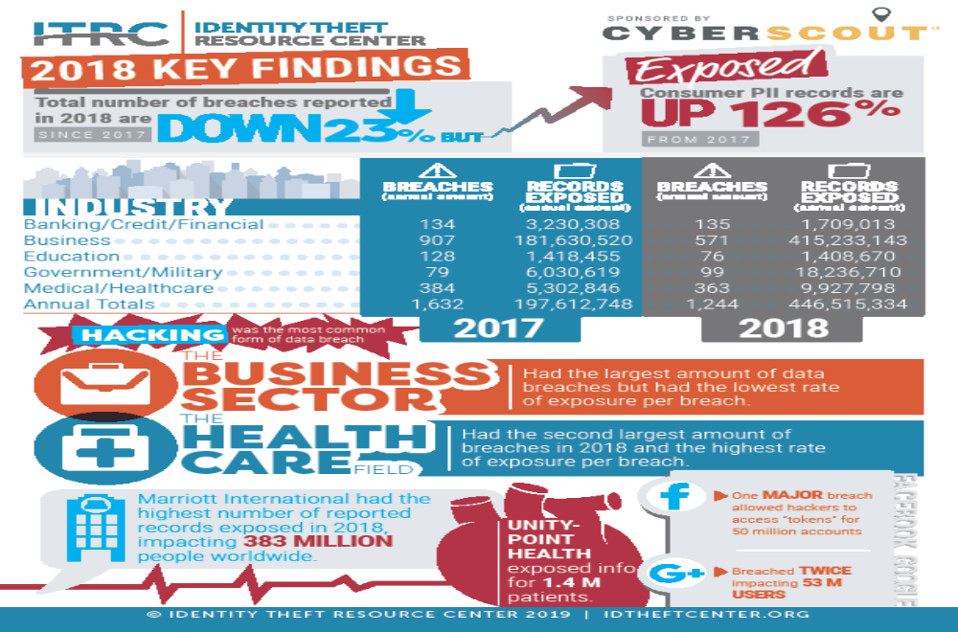

Slide 37
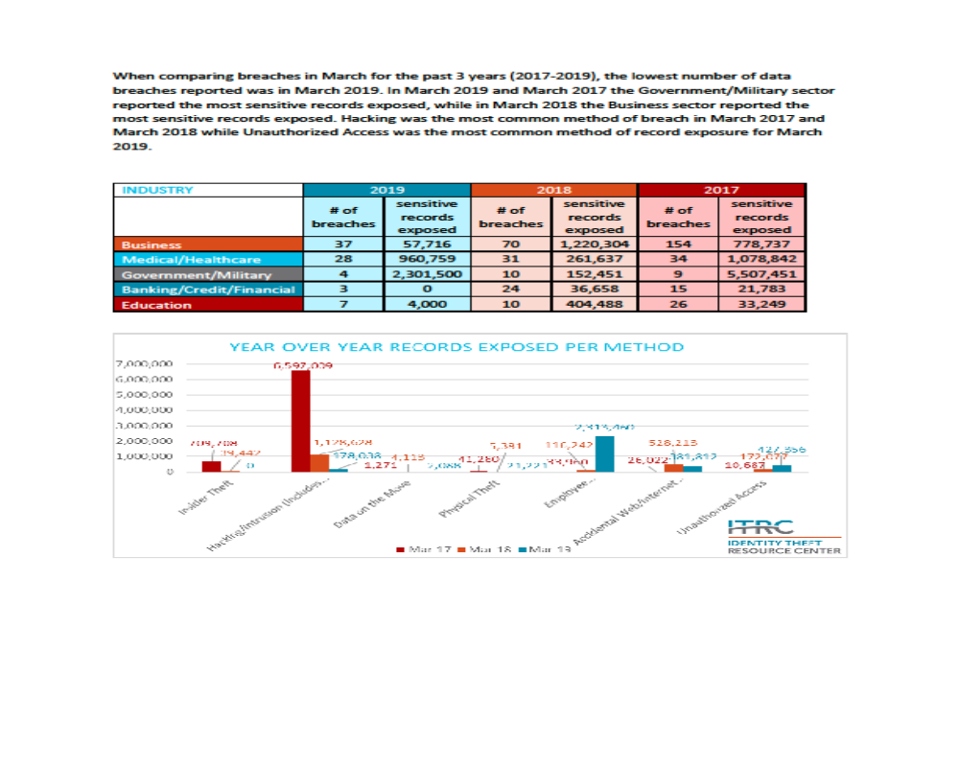

Slide 38
Criminal Identity Theft
Criminal identity theft is the use of false information in connection with the commission of a crime. It includes false information given during a criminal investigation, at the time a citation is issued, or at the time of arrest…
Notes:
Keith
There are two main types of such financial frauds: 1) the use of the victim’s existing credit, bank, or other accounts; or 2) the opening of new accounts in the victim’s name. Many times victims experience both.
Existing Accounts:
According to FTC , about 75% of victims report that the thief misused only their existing accounts.
Credit card accounts are the most commonly misused existing account.
Done by skimming, theft of the cards, etc.
New Accounts:
25% of victims report that thief opened new accounts or committed other types of fraud with the personal info.
Phone accounts, usually wireless: most common type of new account opened by identity thieves.
Thieves also open or raid bank accounts, internet payment accounts, & auto, personal, student loan accounts.
Thief is using personal info of victim to create a new account (may even assume victim’s identity to do so).

Slide 39
Employment Related Identity Theft
This type of identity theft is the use of a victim's personal identifying information by an imposter to get or keep employment.
This type of identity theft happens when an impostor uses a victim's Social Security number or other information to apply for a job or to keep a job…
Notes:
Keith
There are two main types of such financial frauds: 1) the use of the victim’s existing credit, bank, or other accounts; or 2) the opening of new accounts in the victim’s name. Many times victims experience both.
Existing Accounts:
According to FTC , about 75% of victims report that the thief misused only their existing accounts.
Credit card accounts are the most commonly misused existing account.
Done by skimming, theft of the cards, etc.
New Accounts:
25% of victims report that thief opened new accounts or committed other types of fraud with the personal info.
Phone accounts, usually wireless: most common type of new account opened by identity thieves.
Thieves also open or raid bank accounts, internet payment accounts, & auto, personal, student loan accounts.
Thief is using personal info of victim to create a new account (may even assume victim’s identity to do so).

Slide 40


Have You Ever Wondered
Why Identity Theft
Is So Prevalent?

Slide 41
I will ascend above the heights of the clouds
I will be like the Most High
Isaiah 14:14

Slide 42
Identity Theft
Started
In Heaven

Slide 43
Notes:
Consider talking about:
Federal government
State governments
Proposed regulation
Other government efforts

Slide 44
Cyber Bullying
Notes:
Consider talking about:
Federal government
State governments
Proposed regulation
Other government efforts

Slide 45
CYBER BULLIES
Cyberbullying is the electronic posting of mean-spirited messages about a person, often anonymously.
Cyber Tips
Keep your personal information private; avoid sharing your name, address, telephone number, birthday, passwords, and the name of your school when using the Internet.
Think twice before you post or say anything online; once it is in cyberspace, it’s out there forever.
Treat others like you want to be treated.
Speak up. If you see something inappropriate, let the website know and tell an adult you trust. Don’t stand for bullying—online or off.

Slide 46
Cyber Predators
Notes:
Consider talking about:
Federal government
State governments
Proposed regulation
Other government efforts

Slide 47
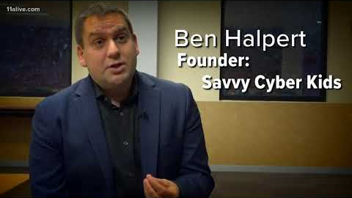

Slide 48
CYBER PREDATORS
Cyber predators are people who search online for other people in order to use, control, or harm them in some way.
Cyber stalking refers to harassing behavior engaged in repeatedly, such as following a person, appearing at a person's home, or leaving written messages or objects.
Cyber Tips:
Create strong passwords. Use a mix of letters, numbers and characters (Example: I love to dance! → 1L0v32Danc3!)
Clean up your online profiles. Don’t include your address or phone number
Lockdown your privacy settings. Make sure to set all of your privacy settings to “private” or “friends only”
Be careful whom you connect with. When using social networking sites, only connect with people who you know in real life (and not just people with mutual friends either)
Avoid using location-based services. “Checking in” to restaurants and other locations can be fun, but it can also be dangerous if someone is stalking you
1 in 5
Americans have been affected by cyber stalking

Slide 49
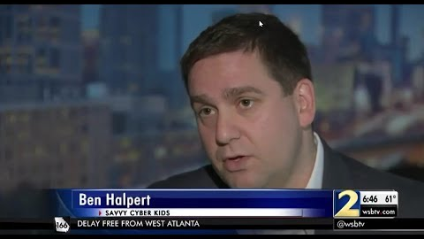

Slide 50
Social Media
Notes:
Consider talking about:
ENISA
NIS Directive
EU GDPR

Slide 51
SOCIAL MEDIA AND THE INTERNET
The world population is 7.6 billion and the internet has 4.1 billion users. Close to half the world’s population (3.03 billion people) are on some type of social media.
Criminals can use information provided in your social media profile, such as your birthday, routine, hobbies, and interests to guess the answers to the security questions on your account or impersonate a trusted friend. Predators appreciate your help if you post your daily routine and whereabouts online.

Slide 52
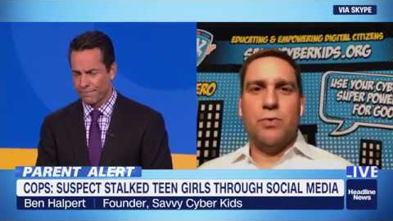

Slide 53
Savvy Cyber Kids
Notes:
Consider talking about:
Support
Opposition

Slide 54
Th3 S@vvy S!x
#1BE INVOLVED.
In order for your children to be successful with technology, you need to be involved in their interactions with it. Do you know your child’s favorite game, app, or social media community (and it changes often!)? If not, ask them! Children love talking about what they do with technology.

Slide 55
Th3 S@vvy S!x
#1BE INVOLVED.
Now that you know their favorite app, game, or social media community, ask your child who they interact with in those digital spaces. Just as you know your children’s friends from the neighborhood or know the
parents of the schoolmate that your child goes home with, you should know who your children’s friends are online.

Slide 56
Th3 S@vvy S!x
#1BE INVOLVED.
Not everything online is appropriate for children to be exposed to. Even if you use a technology solution to filter content that may be age appropriate, the tools may not always work.
In addition, just because you do what you feel is right to protect your children from seeing, reading, or hearing something inappropriate, it does not mean that all their friends’ parents do the same.

Slide 57
Th3 S@vvy S!x
#1BE INVOLVED.
Therefore, you should keep the lines of communication open so that your child will approach you if something upsets them online or if they realize that they made a mistake. If you yell at your children or punish them for bringing something to your attention, that may be the last time they confide in you.

Slide 58
Th3 S@vvy S!x
#2STOP. THINK. CONNECT.™
As our children mature in a digital world, they will have to make their own decisions about appropriate behavior. Every action they take will follow a decision they make. You need to give your children the critical thinking skills to pause, or stop for a moment—when they are about to update social media or take any action online—then have them think about what they are about to do, before potentially posting or forwarding something mean or suggestive—and answer questions like:

Slide 59
Th3 S@vvy S!x
#2STOP. THINK. CONNECT.™
If I forward this picture, will something bad happen to me?
What will people think of me?
What will people think of the other person?
Is this the right thing to do?

Slide 60
Th3 S@vvy S!x
#2STOP. THINK. CONNECT.™
As a family, discuss the idea of privacy. From the youngest ages, children must understand that they should never share their real name and their physical or email address and phone number. But more than that, our young people need to understand that they shouldn’t be sharing the name of the school that they go to—even by wearing a school shirt in a profile picture, where they take after-school activities, family routines or whether Mom and Dad are home or away with anyone that isn’t a friend in real life.

Slide 61
Th3 S@vvy S!x
#2STOP. THINK. CONNECT.™
Our Digital Natives—kids and teens of this current
generation—have a different opinion about what should be private and what is private. Is a text private? A group chat? Our kids trust their friends but do they know how to tell if a friend is trustworthy and do they understand the ways that a text or a group chat can betray their privacy. Debunk the myth of privacy in the virtual world. It 100%
doesn’t exist and your kids need to know that.

Slide 62
Th3 S@vvy S!x
#3STRANGERS ARE FOREVER.
To your children, anyone that reaches out to them via an app, game, or social media community seems like a good person just wanting to chat. Kids are trusting, too trusting. Anyone that your child meets online is a stranger, forever.

Slide 63
Th3 S@vvy S!x
#3STRANGERS ARE FOREVER.
Children today oftentimes don’t distinguish easily between the physical world and the virtual world. They are both real worlds to them. The very concept of a “friend” has been hijacked as any stranger that reaches out to chat and been given new meaning. Until now, because you are involved.

Slide 64
Th3 S@vvy S!x
#3STRANGERS ARE FOREVER.
Make sure your kids understand that
they should NEVER meet someone they met
online, through an app, game, or social
media community in the physical world.
NOT EVER.

Slide 65
Th3 S@vvy S!x
#4UPDATE EVERYTHING.
It is important for you and your children to update all devices and software on a regular basis and when notified by the manufacturer or creator. Anytime an update
(often called a patch) is available, a fix was made to a known problem with that device or software. Perhaps there is a way for someone to remove all the information off of a computer or device. Or maybe there is a way for someone to remotely turn on the video camera on your device and take inappropriate videos.

Slide 66
Th3 S@vvy S!x
#4UPDATE EVERYTHING.
In addition to keeping up with the latest patches, install (and keep updated) an anti-virus product. Antivirus products can protect you from certain attacks. And yes, even Mac computers should have anti-virus software too.

Slide 67
Th3 S@vvy S!x
#5UNDERSTAND TECHNOLOGY.
Make no mistake, if your children can access the internet, strangers with malicious intent can access your children. This means that you need to understand how your children are accessing the internet—whether on a handheld device, on a handheld game, on an iPhone, on an Android phone, a tablet, a computer, a gaming console, a video media player, or other connected device. Whatever the mode of access, you need to understand how these technologies provide direct access for strangers—even pedophiles—to your child.

Slide 68
Th3 S@vvy S!x
#5UNDERSTAND TECHNOLOGY.
It may not be the most exciting literature, but you should read the privacy policy for each device, app, game, or social media community that your child is using. Reading the policy will let you know exactly what information about your children is being collected by the company providing the service AND what
they can do with that information.

Slide 69
Th3 S@vvy S!x
#5UNDERSTAND TECHNOLOGY.
Next, look for the available parental controls for each. Some apps, games, and social platforms offer options that can limit who your child can talk to, as well as who can contact your child. If there is an option to create private profiles, consider doing so and talk to your child about not allowing people they do not know in the physical world to connect with them.

Slide 70
Th3 S@vvy S!x
#6SET SECURITY FREEZES.
The disadvantage of being part of an online community is that all of our personal information is online too (yours and your kids!). If you have ever received a letter from a merchant alerting you to your private information being stolen, you likely were offered free monitoring service for a year or
two—as a method to protect you from identity theft. The reality is that monitoring is not enough. Someone can still open an account in your name and ruin your credit history. You would be alerted after the fact and the credit monitoring firm may help you clean up the mess.

Slide 71
Th3 S@vvy S!x
#6SET SECURITY FREEZES.
There is another option, and it is free
(or inexpensive, depending on where you live). Contact each of the three credit reporting agencies (TransUnion, Equifax, and Experian) and place a security freeze on your credit file. With a security freeze on your credit file, no one can open a new account (take out a mortgage, a car loan, or other financial commitment on your behalf) unless they have your secret pin.

Slide 72
MOBILE SECURITY
A study by Pew Research Center found that almost all Americans (90%) now have a cell phone and 58% own a smartphone.
We are increasingly using phones for banking, online shopping, and social media. The more we travel and access the Internet on the go, the more risks we face on our mobile devices.

Slide 73
MOBILE SECURITY
Tips for Securing Mobile Devices:
Think Before You Connect. Before you connect to any public Wi-Fi hotspot, confirm the name of the network and exact login procedures to ensure that the network is legitimate.
Guard Your Mobile Device. In order to prevent theft, unauthorized access, and loss of sensitive information, never leave your mobile devices unattended in a public place.

Slide 74
MOBILE SECURITY
Tips for Securing Mobile Devices:
Keep It Locked. Always lock your device when you are not using it. Use strong PINs and passwords to prevent others from accessing your device.
Update Your Mobile Software. Keep your operating system software and apps updated, which will improve your device’s ability to defend against malware.

Slide 75
MOBILE SECURITY
Tips for Securing Mobile Devices:
Only Connect to the Internet if Needed. Disconnect your device from the Internet when you aren’t using it and make sure your device isn’t programmed to automatically connect to Wi-Fi.

Slide 76
MOBILE SECURITY
Tips for Securing Mobile Devices:
Know Your Apps. Be sure to thoroughly review the details and specifications of an application before you download it. Delete any apps that you are not using to increase your security. Double-check how the app will be using your information (Example: does it need access to your pictures or contact list? If so, why?)

Slide 77
MOBILE SECURITY
When you play games, video chat, or surf the web on a cell phone or tablet, you are accessing the Internet on the go. We need to be careful when using cell phones just like we are careful when using a computer.
Cyber Tips for Kids
Keep a close eye on your mobile device. Never leave your mobile devices unattended.

Slide 78
MOBILE SECURITY
When you play games, video chat, or surf the web on a cell phone or tablet, you are accessing the Internet on the go. We need to be careful when using cell phones just like we are careful when using a computer.
Cyber Tips for Kids
Keep It Locked. Always lock your device when you are not using it. Use strong passwords to prevent others from accessing your device. Never share your passwords with someone other than your parent or guardian.

Slide 79
MOBILE SECURITY
When you play games, video chat, or surf the web on a cell phone or tablet, you are accessing the Internet on the go. We need to be careful when using cell phones just like we are careful when using a computer.
Cyber Tips for Kids
Know Your Apps. Check with your parents before you download an app and review the settings with them.

Slide 80
MOBILE SECURITY
When you play games, video chat, or surf the web on a cell phone or tablet, you are accessing the Internet on the go. We need to be careful when using cell phones just like we are careful when using a computer.
Cyber Tips for Kids
Only Connect to the Internet if Needed. Disconnect your device from the Internet when you aren’t using it and make sure your device isn’t set to automatically connect to Wi-Fi.

Slide 81
COMMON SENSE RULES
APPLY ONLINE
Don’t talk to strangers. Don't communicate with strangers online and never agree to meet in person. Tell a parent, teacher, or an adult you trust if a stranger contacts you in a chat room, through email, or via text messaging.
Look both ways before crossing the street. Don't enter contests, join clubs, or share your personal information for any reason, unless your parents say it's OK. Your name, address, age, phone number, birthday, email address, where you go to school, and other facts about you are personal and shouldn’t be shared without checking first.
If the offer seems too good to be true, then it probably is. How many of you have ever received an email offering something free, like a cell phone or concert tickets? These are tricks designed to get you to give up personal information or click on links to automatically install malware or spyware.

Slide 82
The End

